Slide 1

S12 Patient Monitor
BIOLIGHT
Kaka Shaw

Slide 2
Catalogue
Appearence◀
Configuration
New Functions
Upgrate
Patient central station
Internal structure
Maintenance & Cleaning
Notes

Slide 3
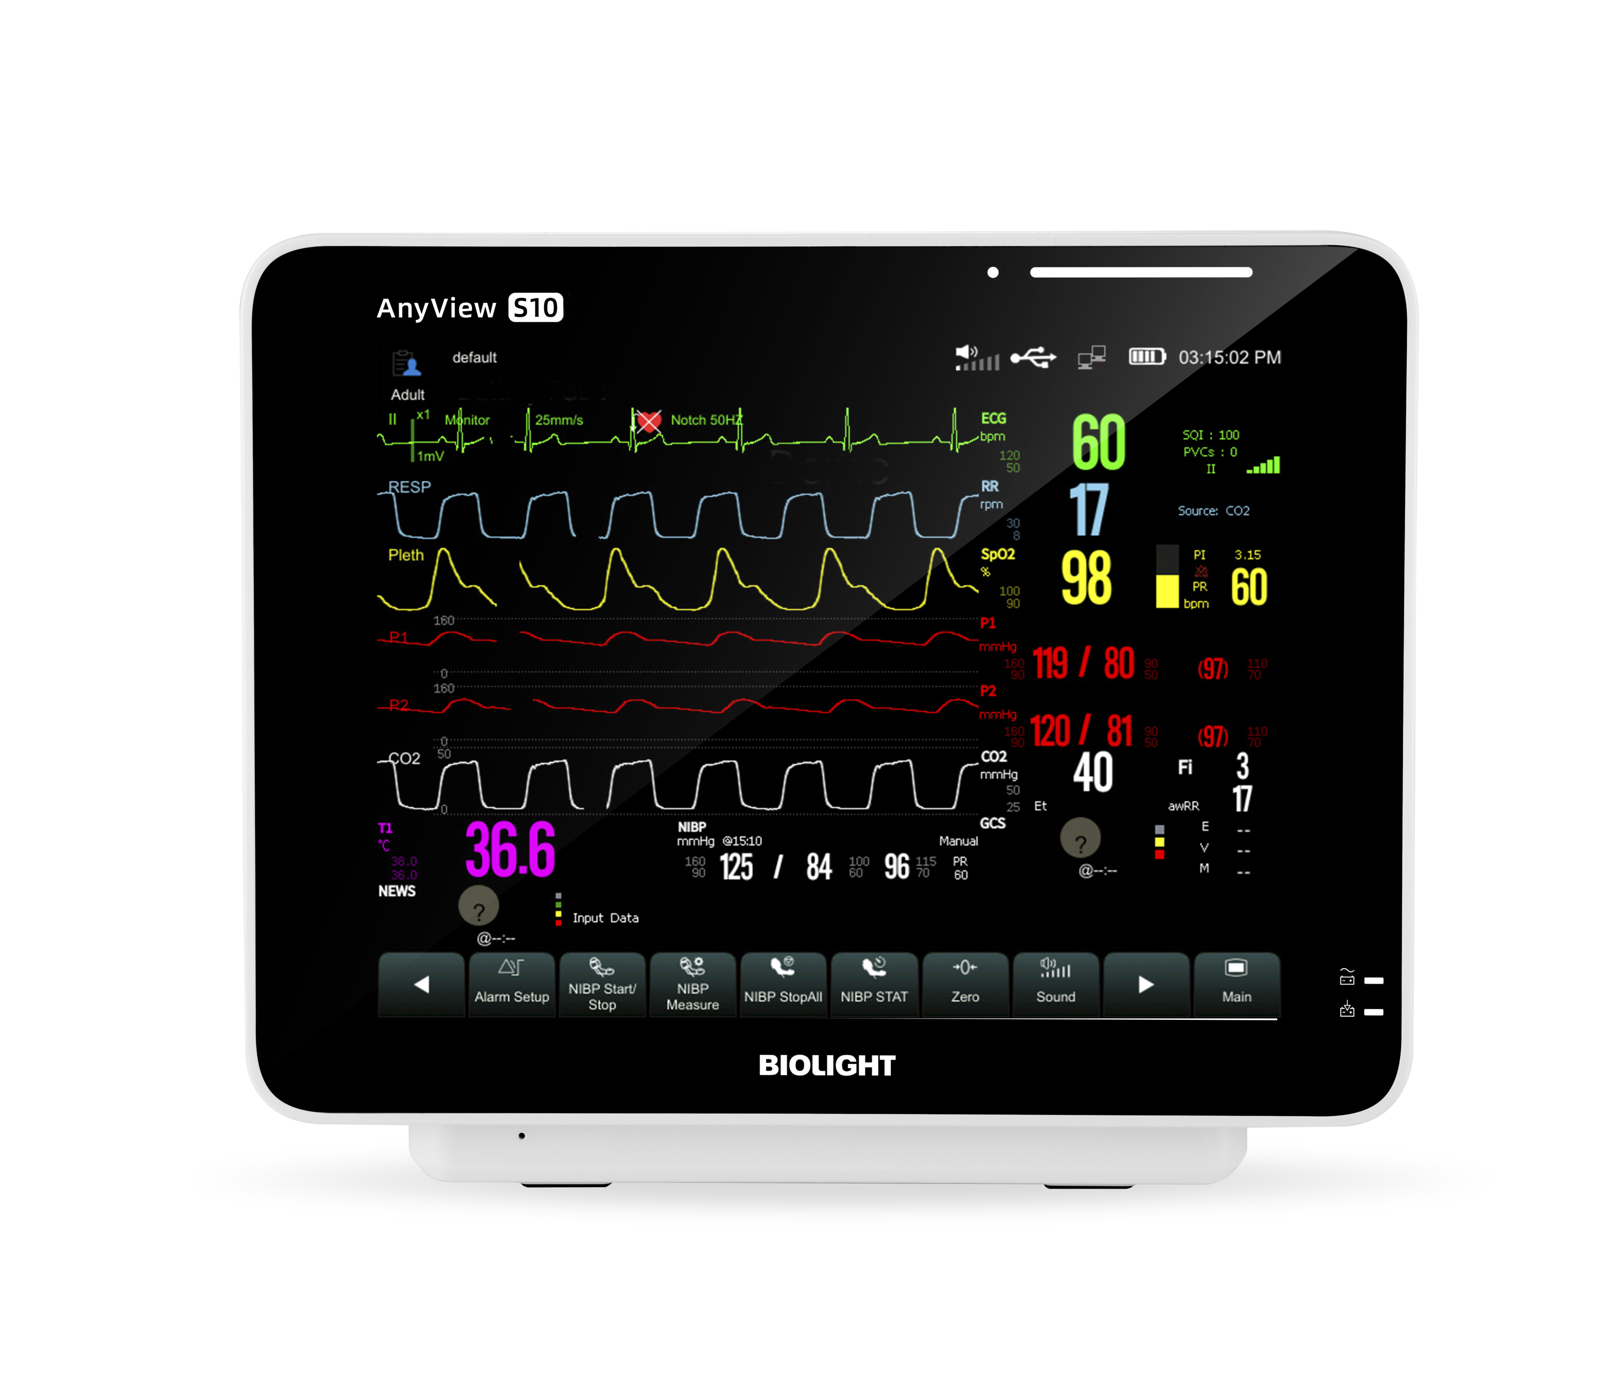
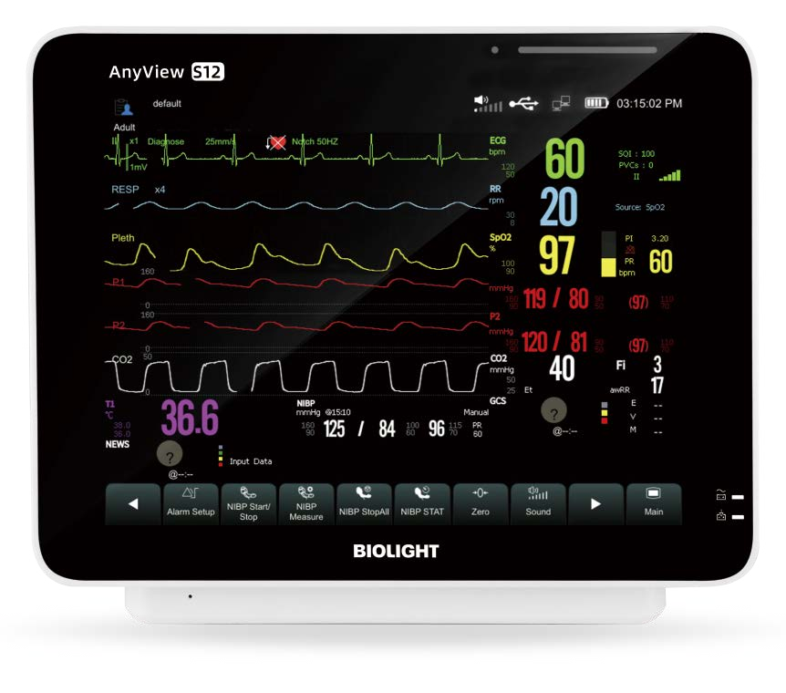
S12
12.1 inch screen
S10
10.4 inch screen

Slide 4
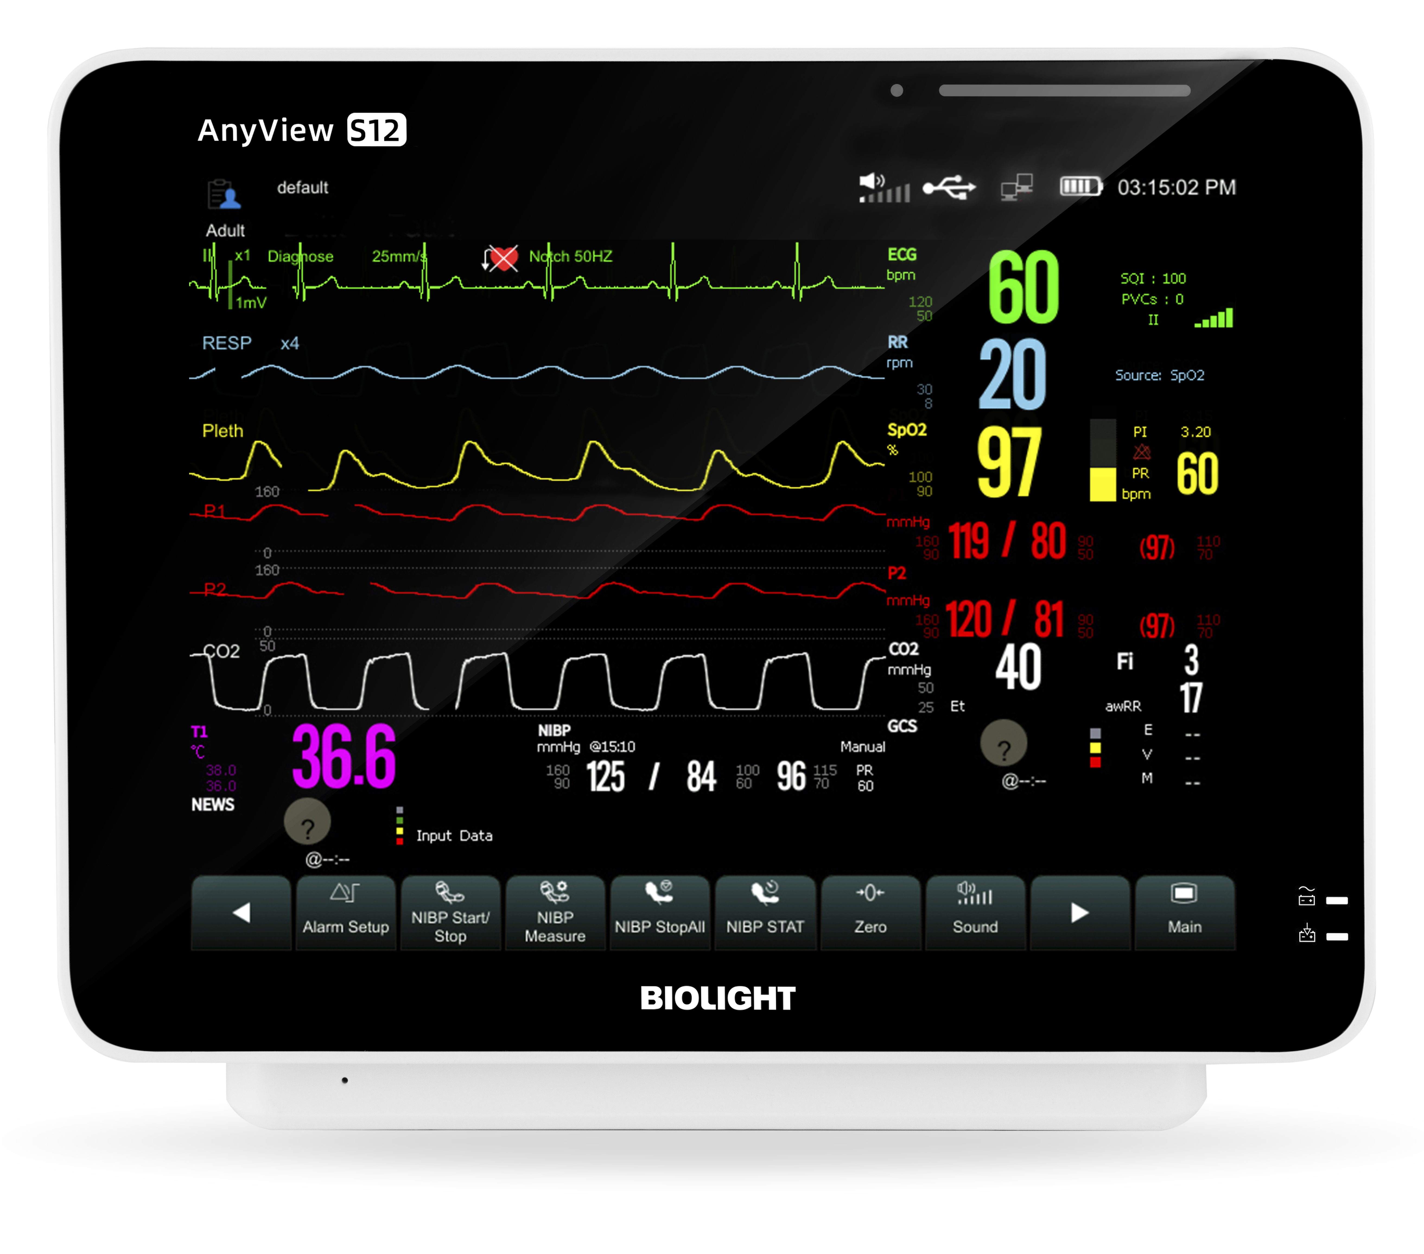
Appearence
Light induction
Alarm lamp
Display screen
Power indicating lamp
Battery charging
indicating lamp

Slide 5
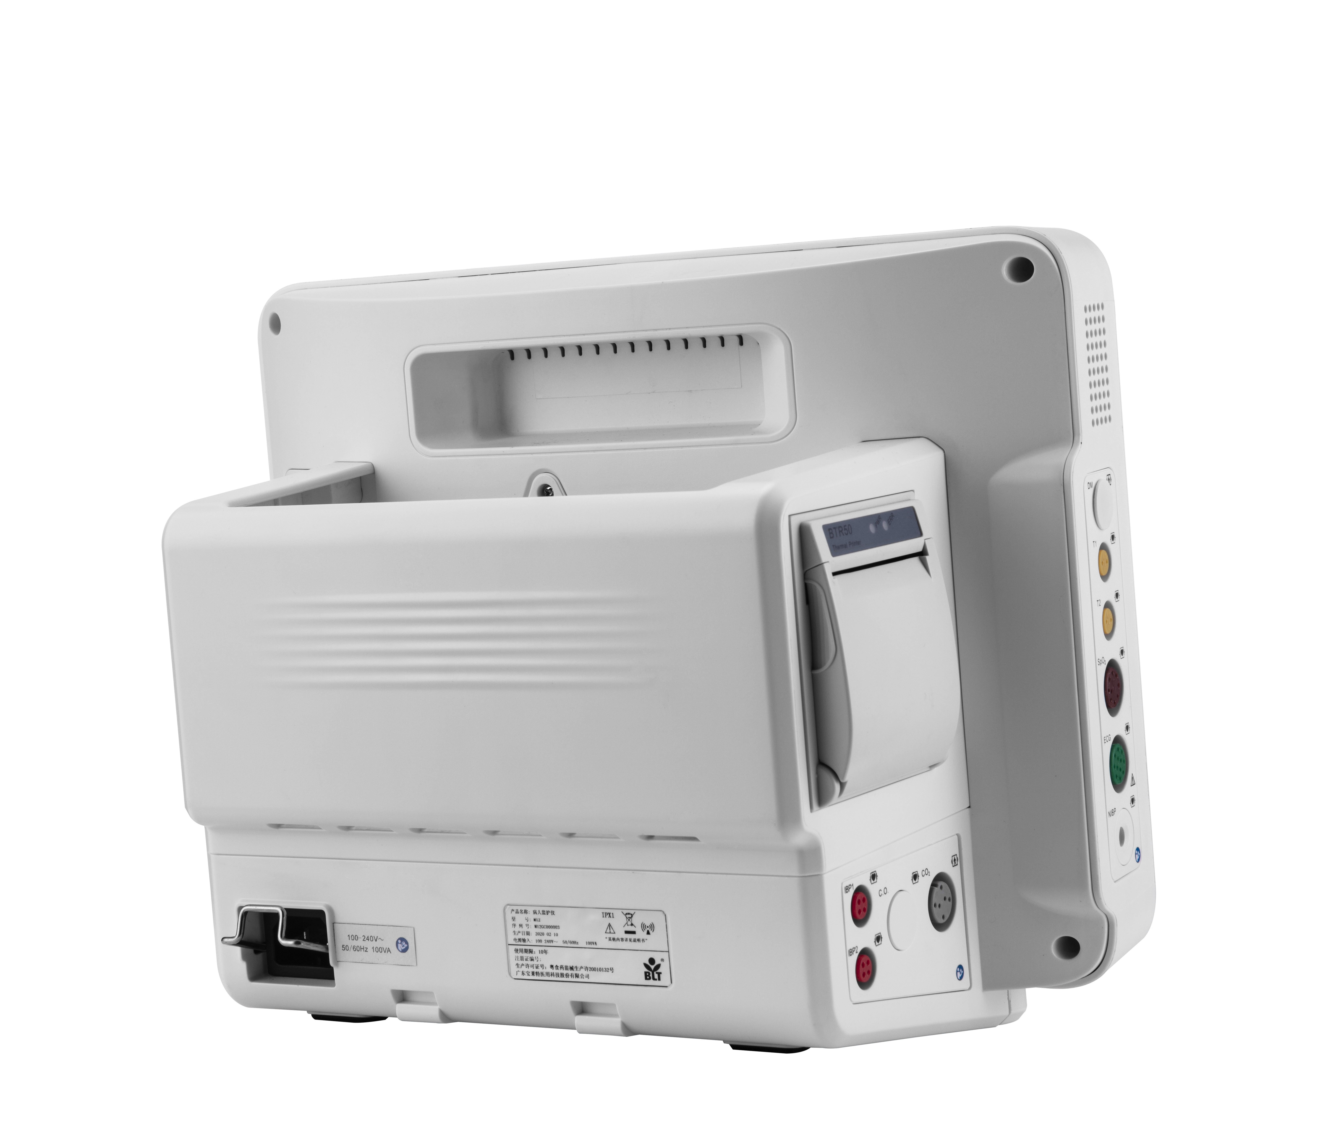
Appearence
Recorder（optional）
Handle
dual channel TEMP connectors
Storage box
SPO₂connector
ECG connector
NIBP connector
AC power socket
IBP connector
（Optional）
EtCO2 connector
（optional）

Slide 6
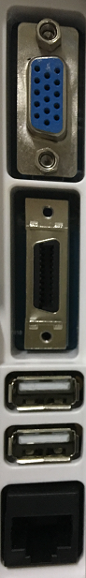
Appearence
VGA connector
(optional)
Multifunction
connector
(optional)
USB connector
Network connector
Power button
Grounding terminal

Slide 7
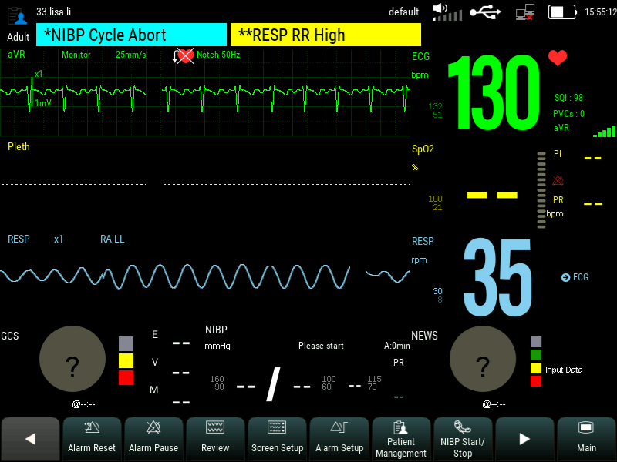
Appearence
Patient info area
Physiological alarm area
System status information area
Technical alarm area
Waveform area
Parameter area
quick keys

Slide 8








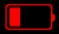
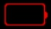



Appearence
Symbol | Note | Symbol | Note
 | Wired network connected |  | Wired network not connected.
 | All the alarms are paused. |  | The parameter alarm is turned off or the alarm system of the monitor is turned off.
 | The alarm has been confirmed and the alarm system has been reset. |  | Audible alarm tones are turned off.
 | Indicates that the battery is fully charged. |  | Indicates that the battery is half charged.
 | Indicates that the battery is empty and needs to be charged. |  | Indicates that the battery is almost depleted and need to be charged immediately,otherwise the monitor will automatically turn off.
 | Indicates that the battery is being charged. |  | Indicates that the monitor is being powered by AC power.
 | No battery is installed.

Slide 9
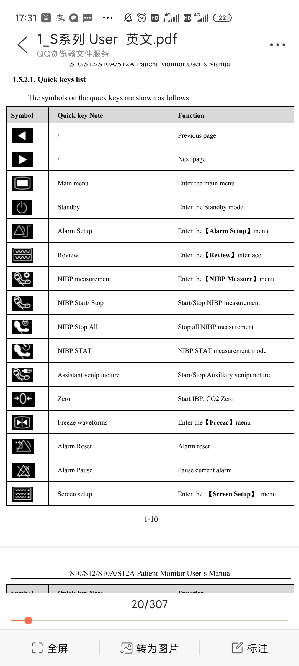
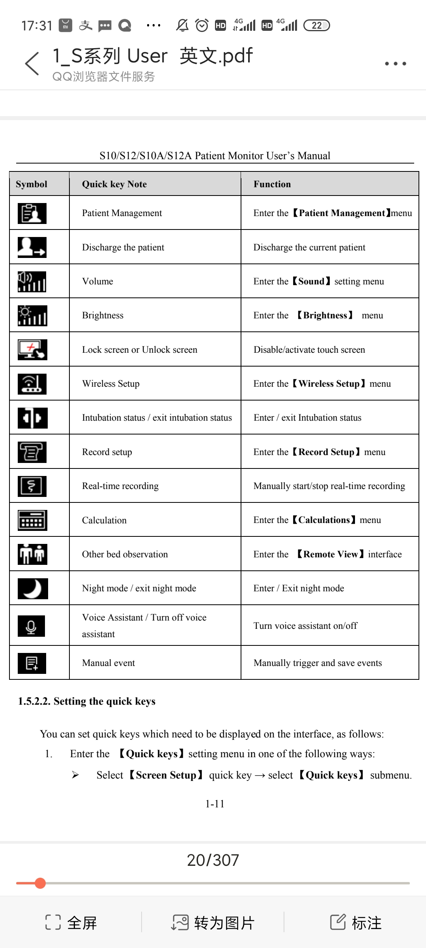
Appearence

Slide 10
Catalogue
Appearence
Configuration ◀
New Functions
Upgrate
Patient central station
Internal structure
Maintenance & Cleaning
Notes

Slide 11
Configuration
 | Standard configuration | Optional configuration
S12 | Touch screen， 3/5 lead ECG，HR, RESP, BLT-NIBP, BLT-SPO₂，PR 2-TEMP lithiumbattery (2500mAh), Adult accessories | 2-IBP, 12 lead ECG EtCO2 (Masimo/BLT mainstream/Side stream) Recorder, WIFI, Extension interfaces (VGA ,Analog output, Defibrillation synchronization, Nurse calls, ) Lithium battery (5000mAh)

Slide 12
Battery
 | 2500mAh/11.1V | 5000mAh/11.1V
Type | Rechargeable lithum ion battery
Operating time | ≥4h | ≥8h
Charge time | 3hours 90% , 4 hours 100% (off) 5hours 90% , 6 hours 100% (on) | 6hours 90% , 8 hours 100% (off) 11hours 90% , 12 hours 100% (on)
Turn off delay | 5min-15min（after the low battery alarm first occurs）
It is recommended to change the battery every three years
Notes:
In a new and fully charged battery at(25℃）ambient temperature,typical configuration (connected to SPO₂；not connected to ECG and TEMP cable，and NIBP works in an automatic measurement mode with a time interval of 30min；Screen brightness is the factory default value；not connected to recorder）

Slide 13
Catalogue
Appearence
Configuration
New Functions◀
Upgrate
Patient central station
Internal structure
Maintenance & Cleaning
Notes

Slide 14
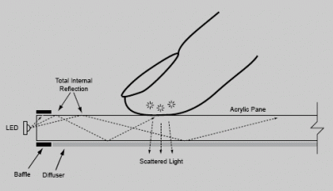
New Functions
Gesture-operable
Adjust the brightness of the screen (≥2 contacts slide up and down in the left half of the screen)
Adjust the alarm volume (≥2 contacts slide up and down on the right half screen)
Switch the interface (≥2 contacts slide left and right on the touch screen)

Slide 15
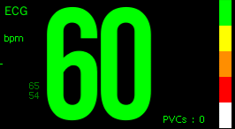
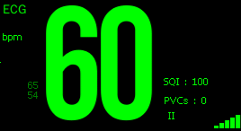
New Functions
ECG signal quality
The five colors from top to bottom correspond to the multi-channel signal quality from high to low.
Both SQI value and signal icon represent the quality of main lead signal.

Slide 16
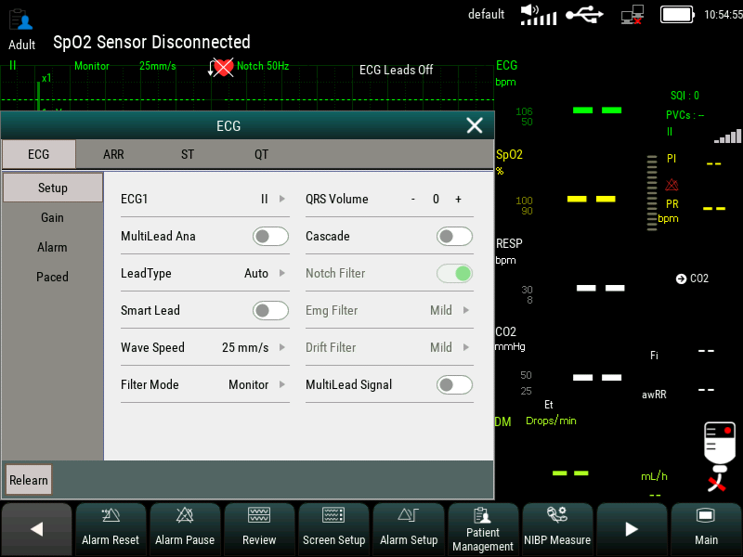
New Functions
Automatic lead switching
ECG multi-lead calculation and automatic lead switching, which can automatically switch the ECG lead according to the signal quality, to ensure the stability and reliability of HR.

Slide 17
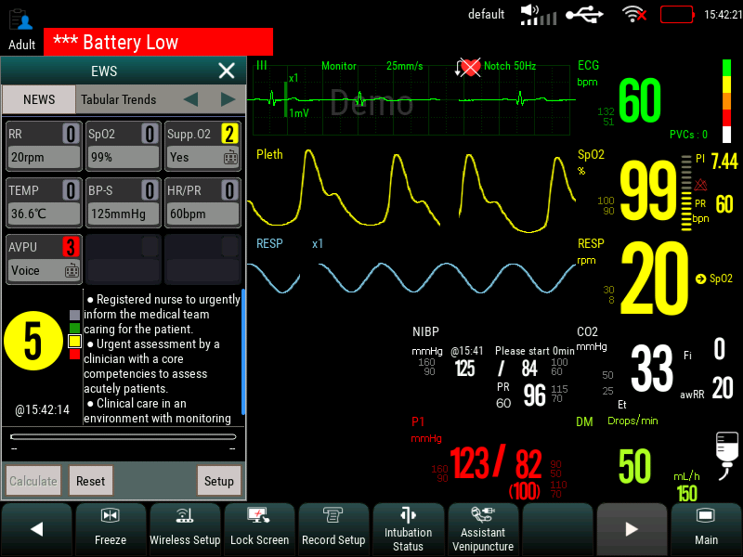
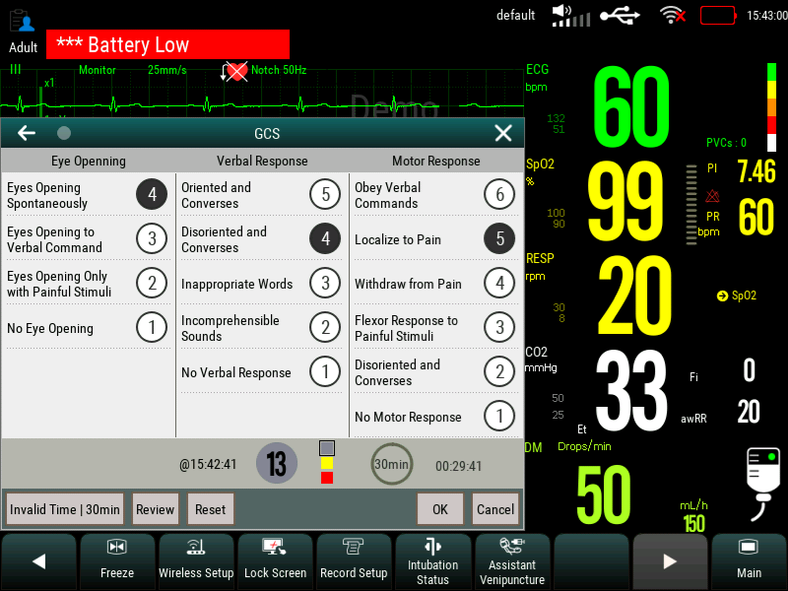
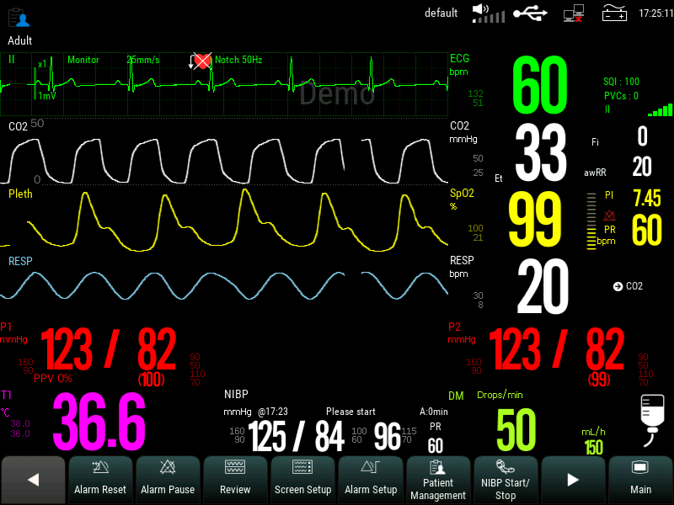
New Functions
Patient condition assessment
EWS
GCS
PPV
EWS, CGS and PPV can help medical staff to evaluate the patient's condition and EWS can make suggestions.

Slide 18
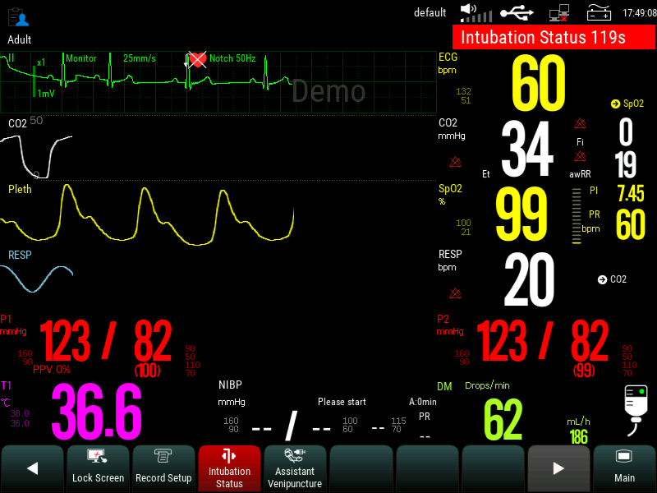
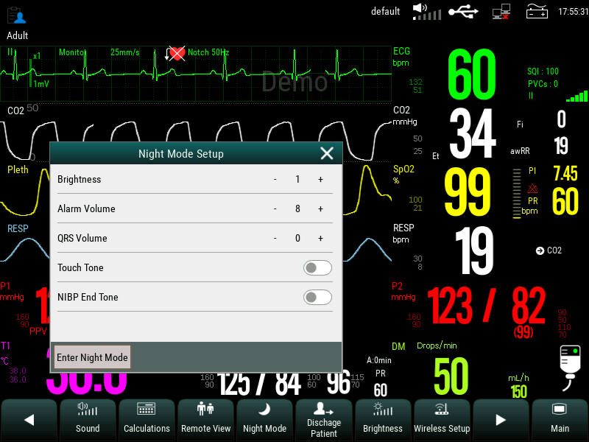
New Functions
Night mode
Intubation mode

Slide 19
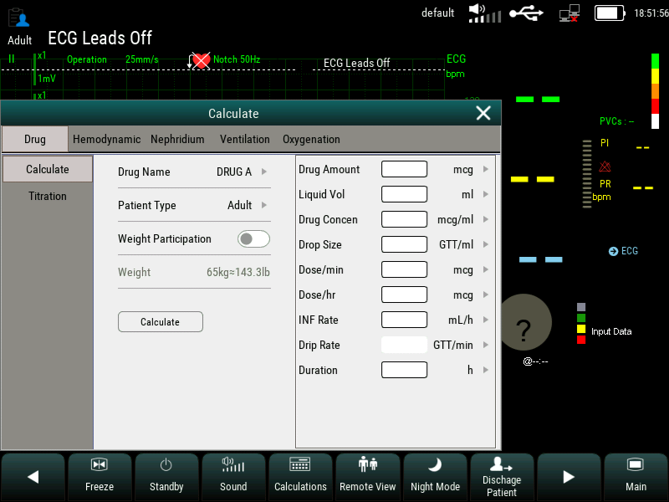
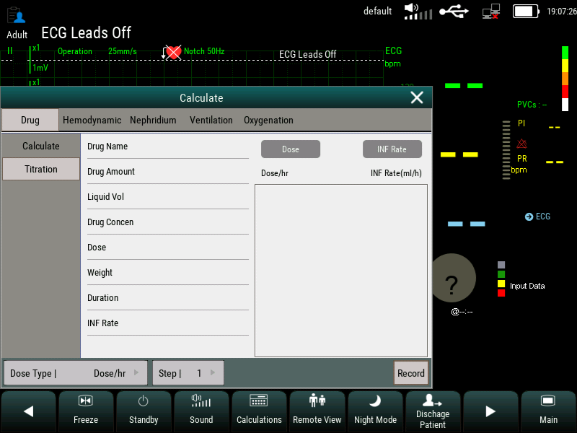
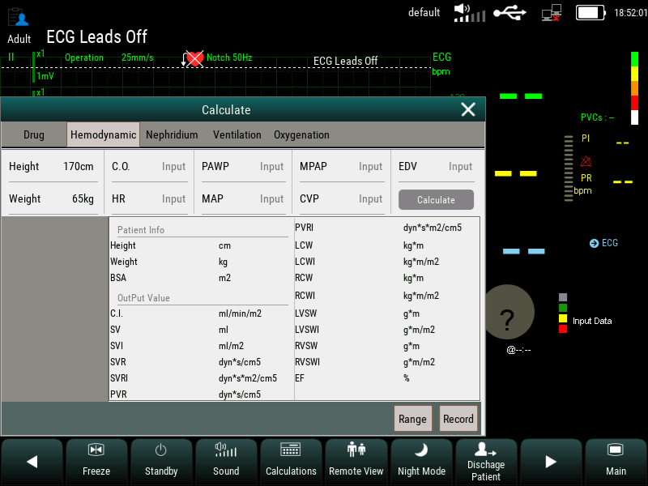
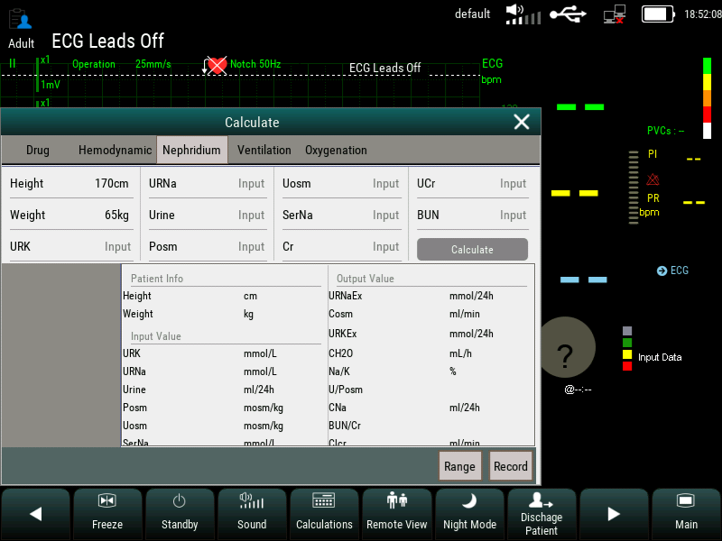
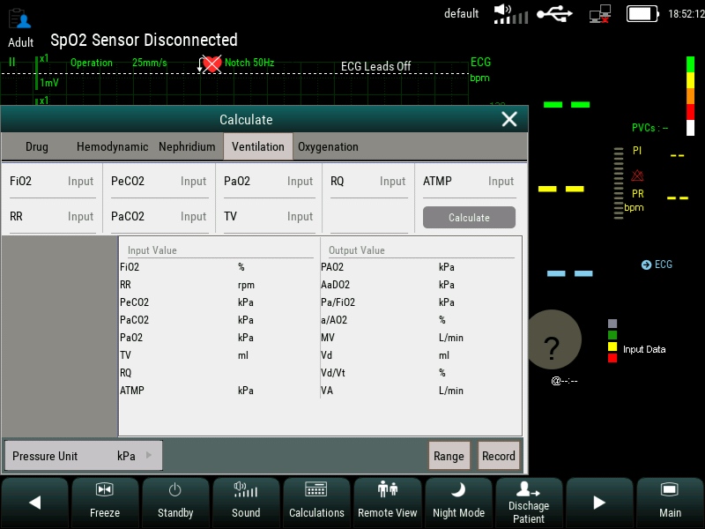
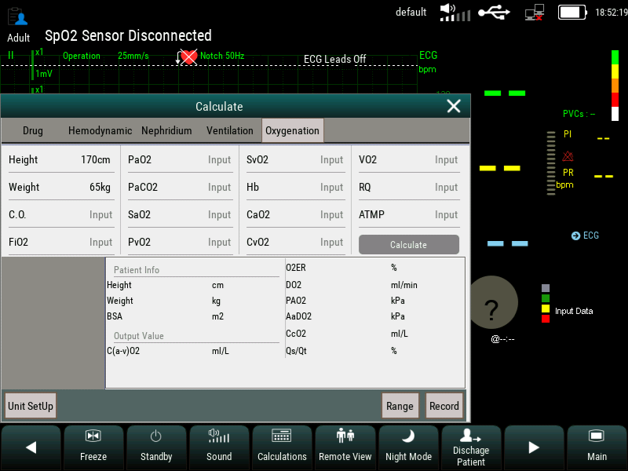
New Functions ----
Caculations
drug
Titration
Hemodynamic
Nephridium
Ventilation
Oxygenation

Slide 20
New Functions
Trends | Long trend:1800h,minimum resolution is 10 min.
 | Medium trend:180h,minimum resolution is 1 min.
 | Short trend ：6h，minimum resolution is 5 second.
Alarm event | At least 3000 parameter alarm events and associated parameter waveform at the moment.
ARR events | 3000 ARR events，and the parameter waveform related to the time of event occurence.
NIBP measurement result | At least 2400 groups.
Holographic waveform | 72 hours at maximum.The specific storage time depends on the waveforms stored and the number of stored waveform.

Slide 21
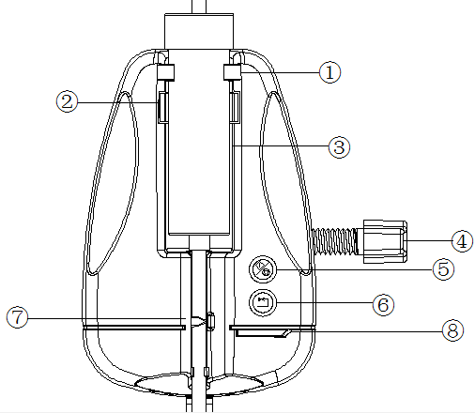


New Functions---DM
Clamps
Infrared filter
Dropping brucket
Fixing clamp
Start/stop
Liquid stop clamp
Reset
Indicating
lamp
⑤Start or stop infusion drip speed monitoring.
⑥When the liquid stop clamp is in the liquid stop state, press the reset key to open the liquid stop clamp.

Slide 22
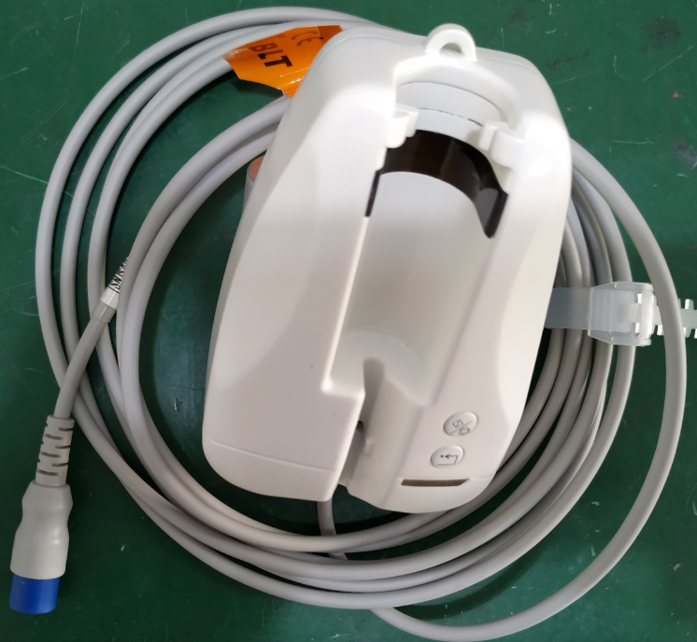
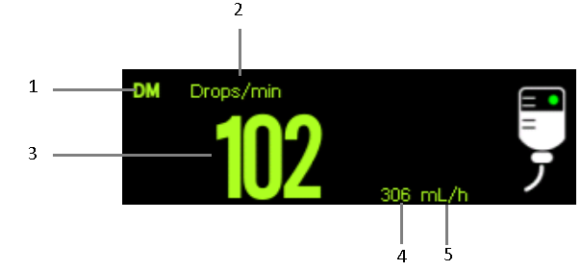
New Functions---DM
Drip rate unit (main unit)
Parameter Label
The value of drip rate
The value of
flow rate
Working
state diagram
The indicator light is yellow：standby
The indicator light is red ：Alarm status
The indicator light is green：functional mode

Slide 23
Catalogue
Appearence
Configuration
New Functions
Upgrate◀
Patient central station
Internal structure
Maintenance & Cleaning
Notes

Slide 24
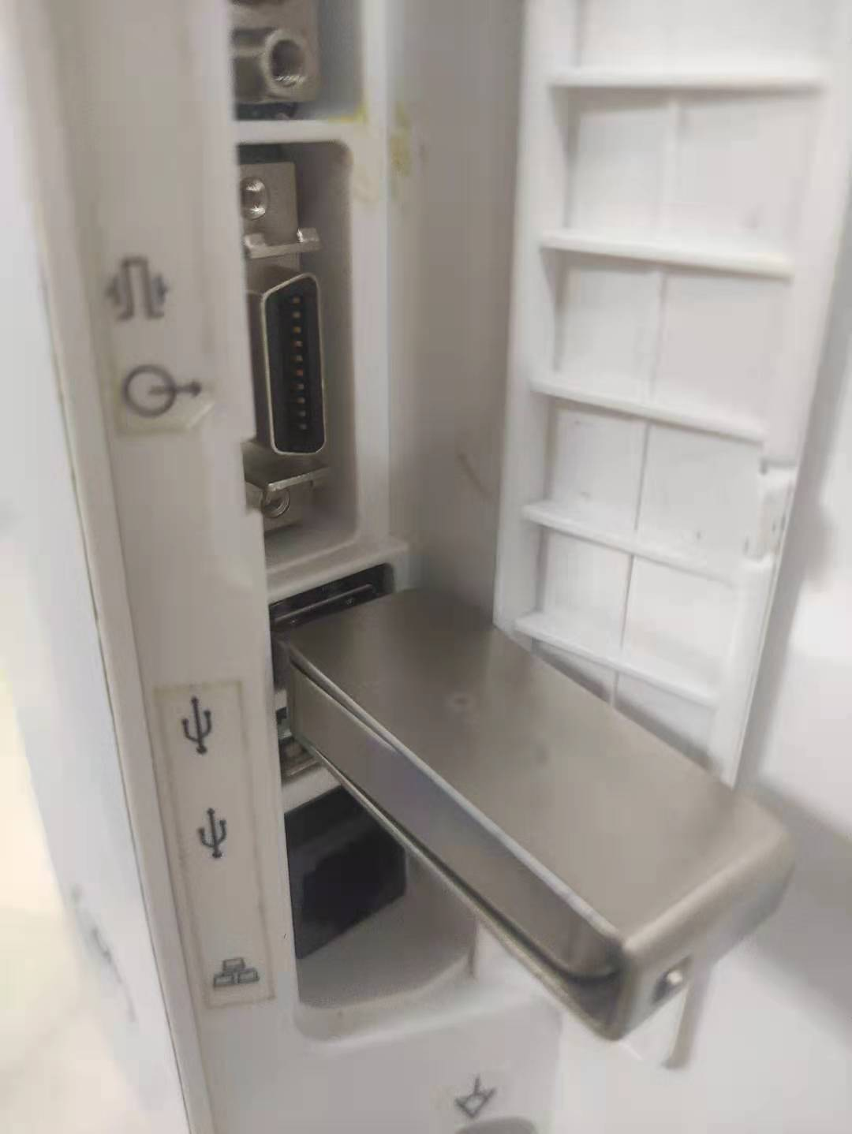
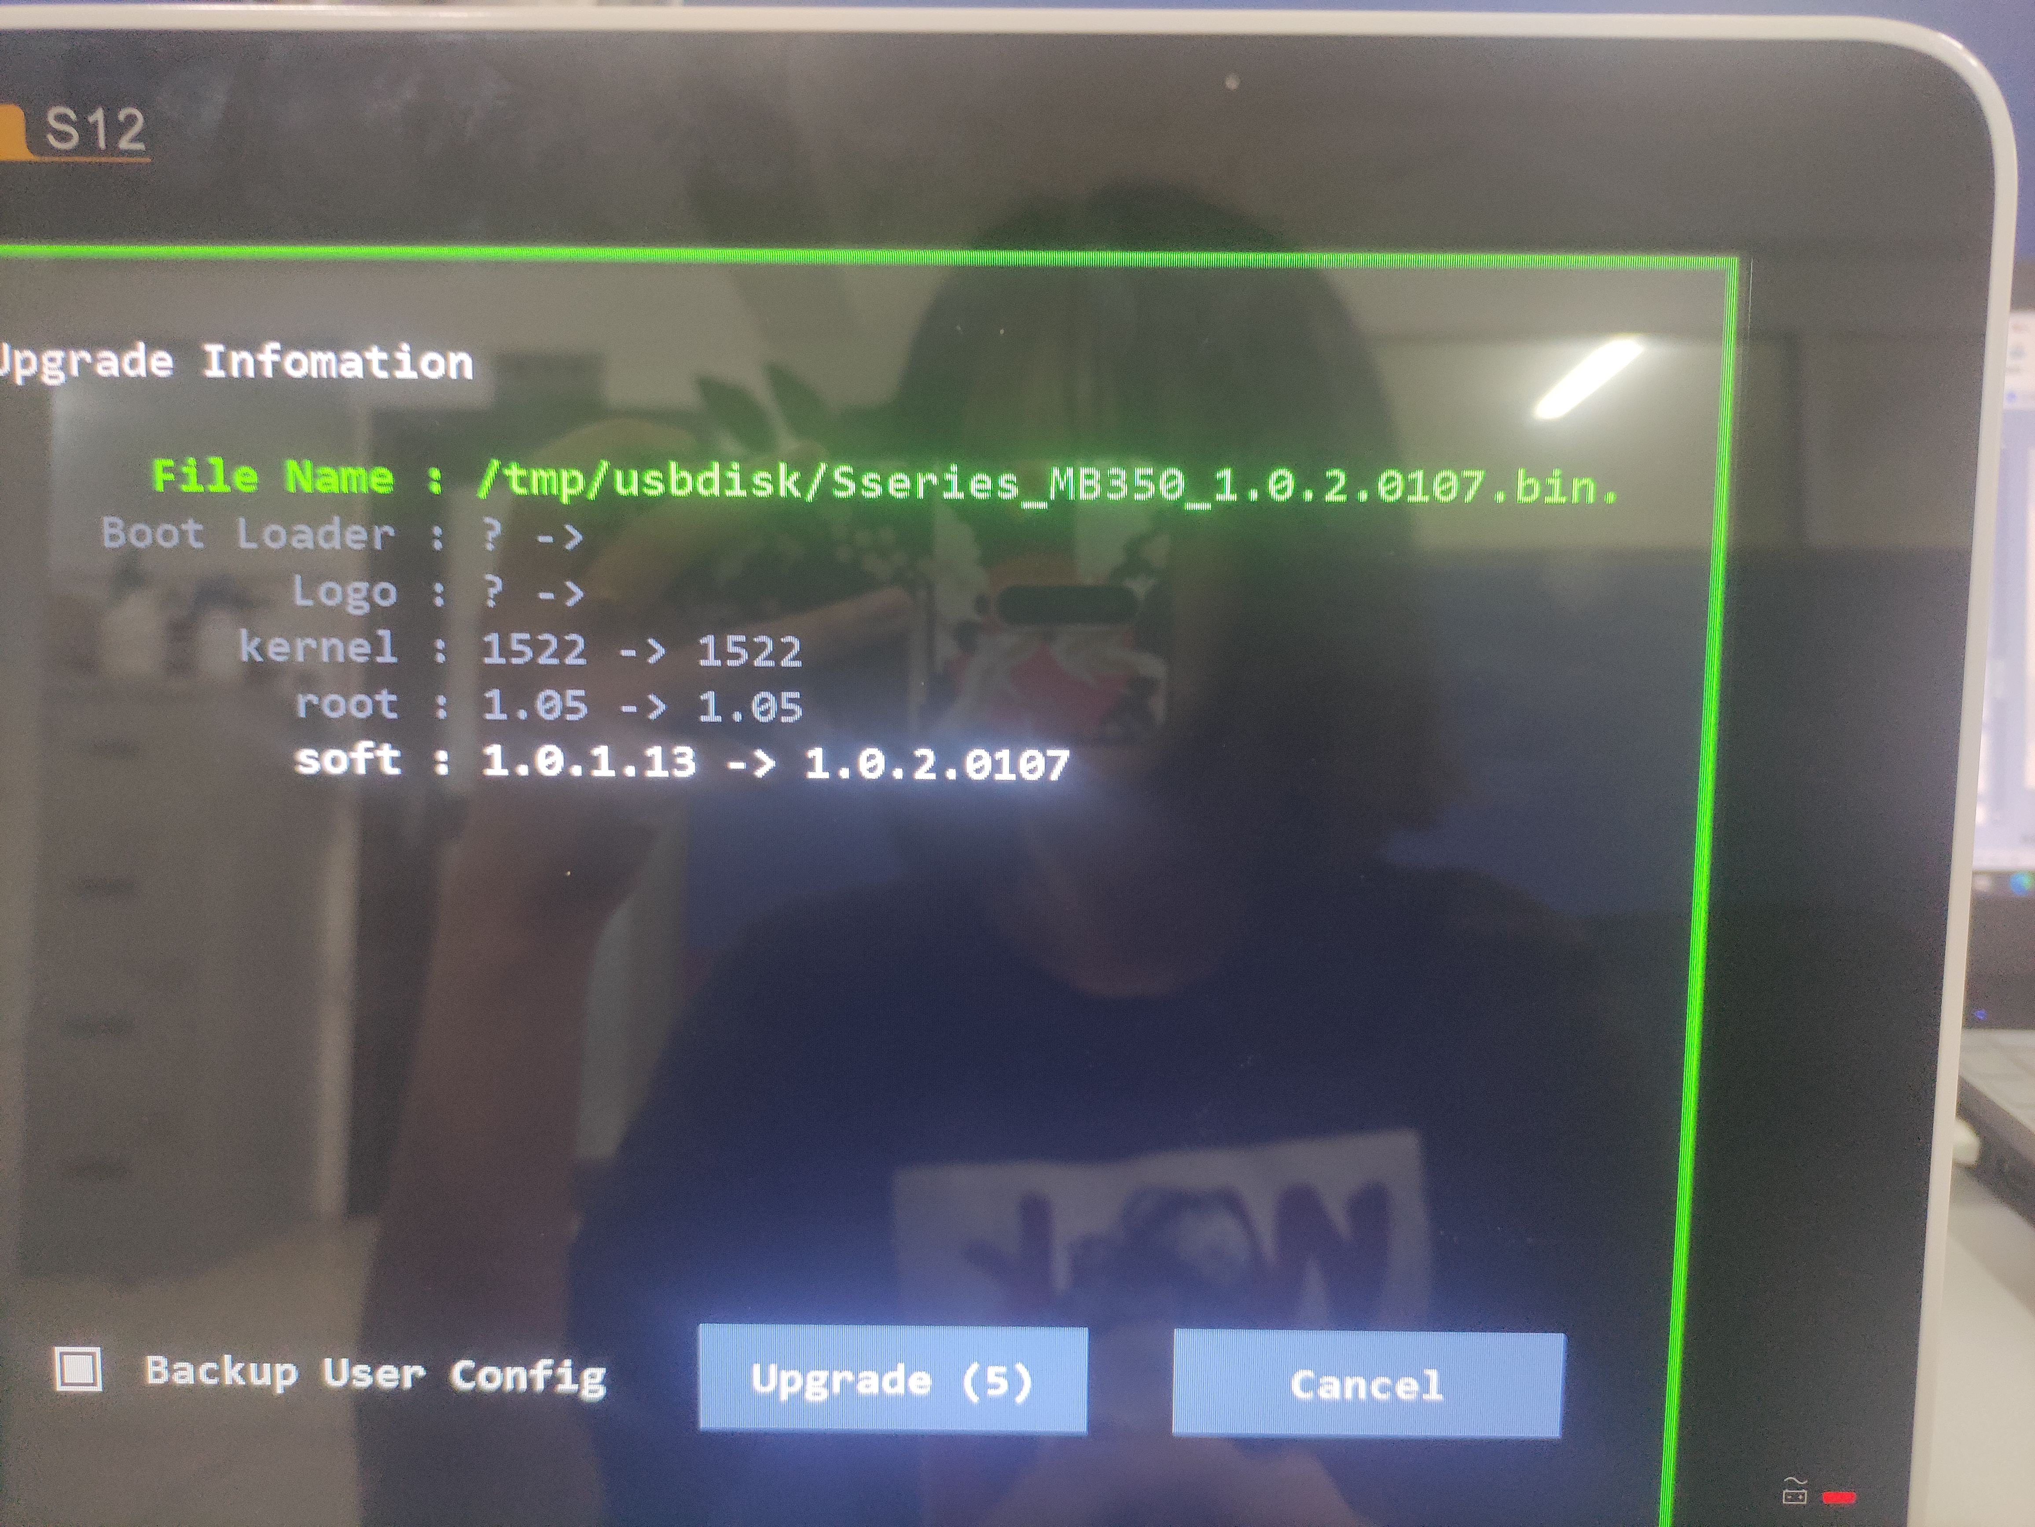
Take the upgrate software into pen drive and put into machine
Click “Upgrate”

Slide 25
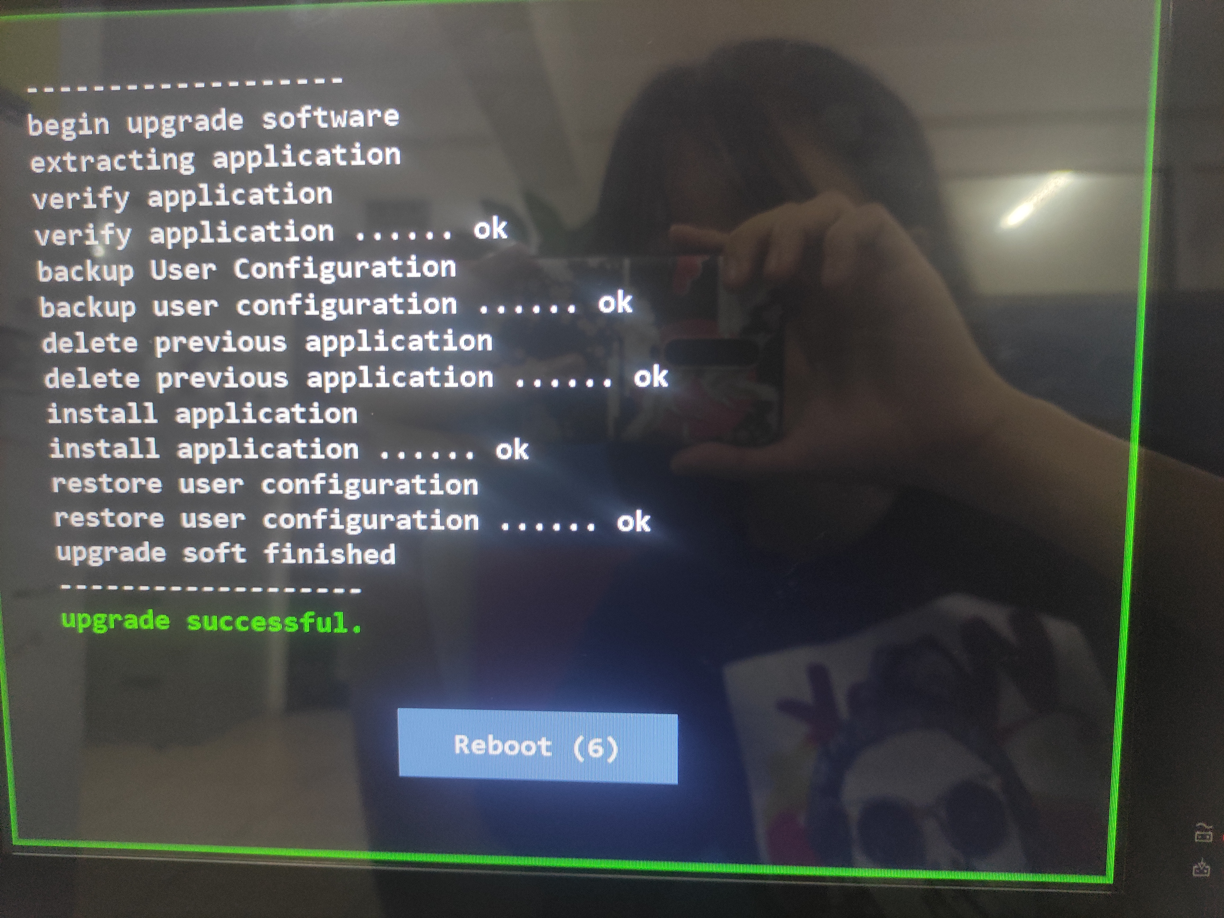
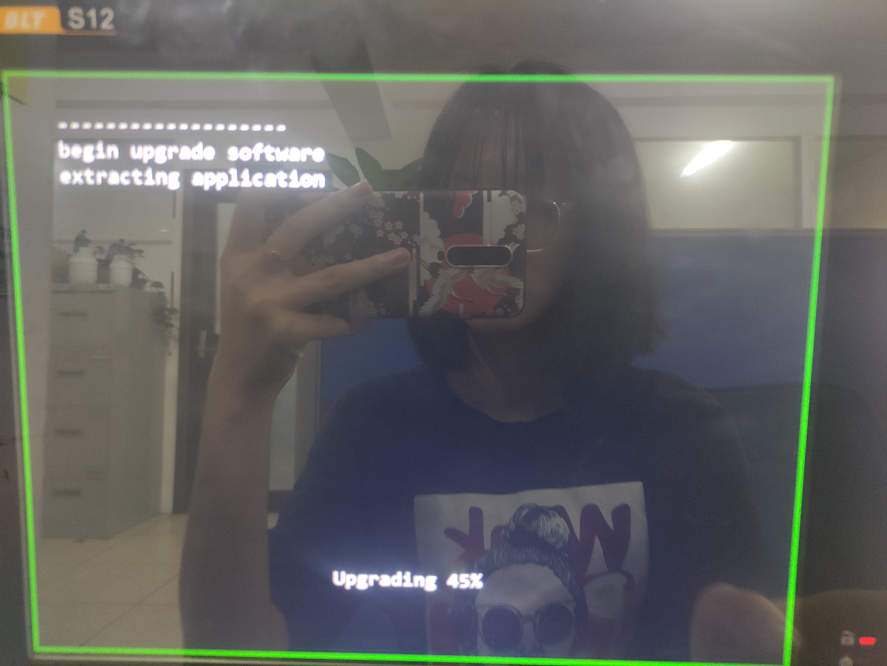
Waiting for it
Before your click the “Reboot “,u must pull out the pen drive

Slide 26
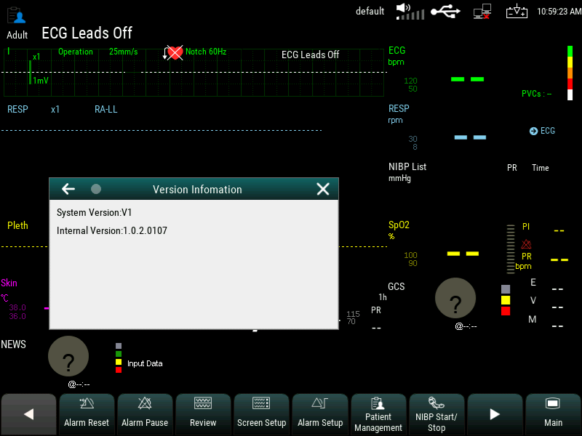
Upgrate is complete

Slide 27
Catalogue
Appearence
Configuration
New Functions
Upgrate
Patient central station ◀
Internal structure
Maintenance & Cleaning
Notes

Slide 28
Alarm information
Device number
Exit buttom
Yellow:alarm
Green:normal
Black:not connect
Patient central station
Indicator of statu

Slide 29
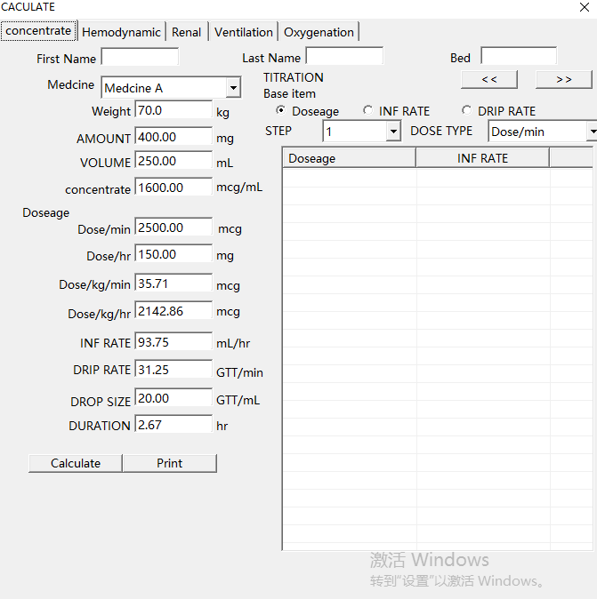
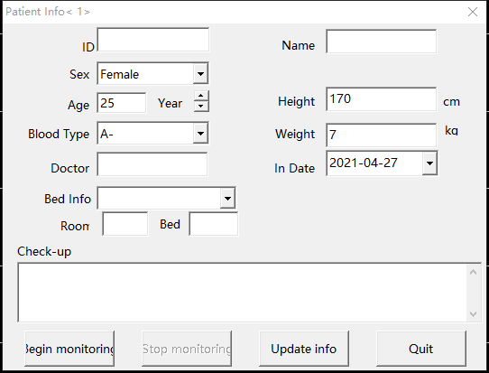
Caculator
Patient information

Slide 30
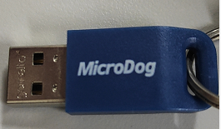
How to install the central station
Dongle
Shutdown.exe
<Downloading M6000C>→<Enter the M6000C document>→<Delete the “shutdown.exe” or change its name>→<plug into the dongle>

Slide 31
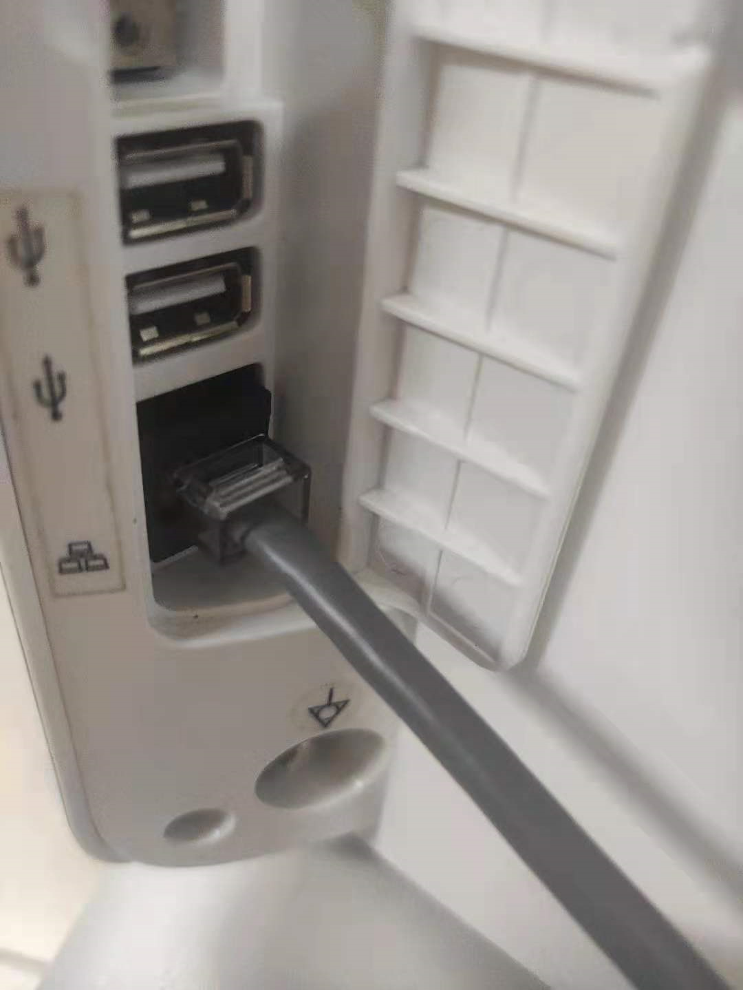
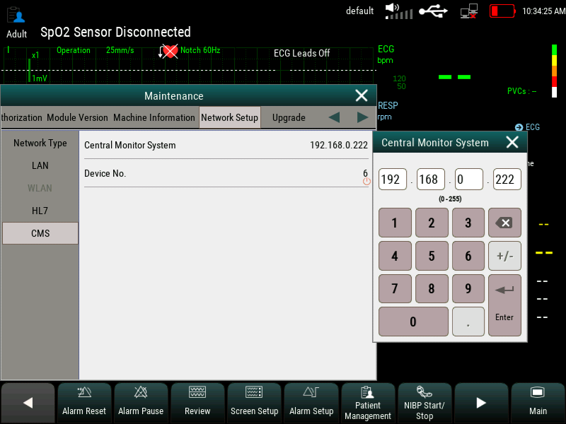
How to connect the central station
Enter the maintanance→the password is 785623
Connect the machine and computer use network cable

Slide 32
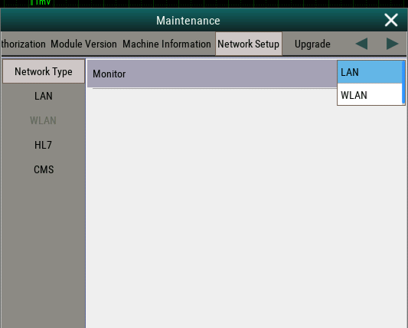
How to connect the central station
Network Setup→Network Type→choose LAN
Check the computer IP→CMS→Central Monitor System→Enter the computer IP

Slide 33
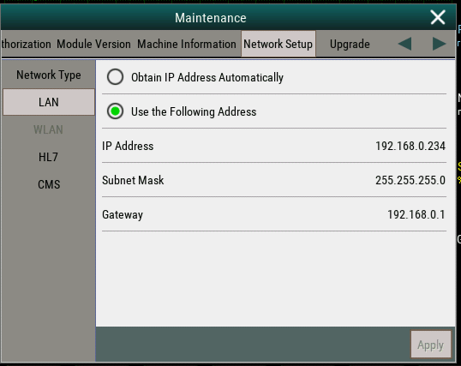
How to connect the central station
LAN→to change the IP Address' network segment are the same as your computer IP→change the Subnet Mask is the same as your computer Subnet Mask→change Gateway is the same as your computer.
When you are done with all the settings, please remember restart.

Slide 34
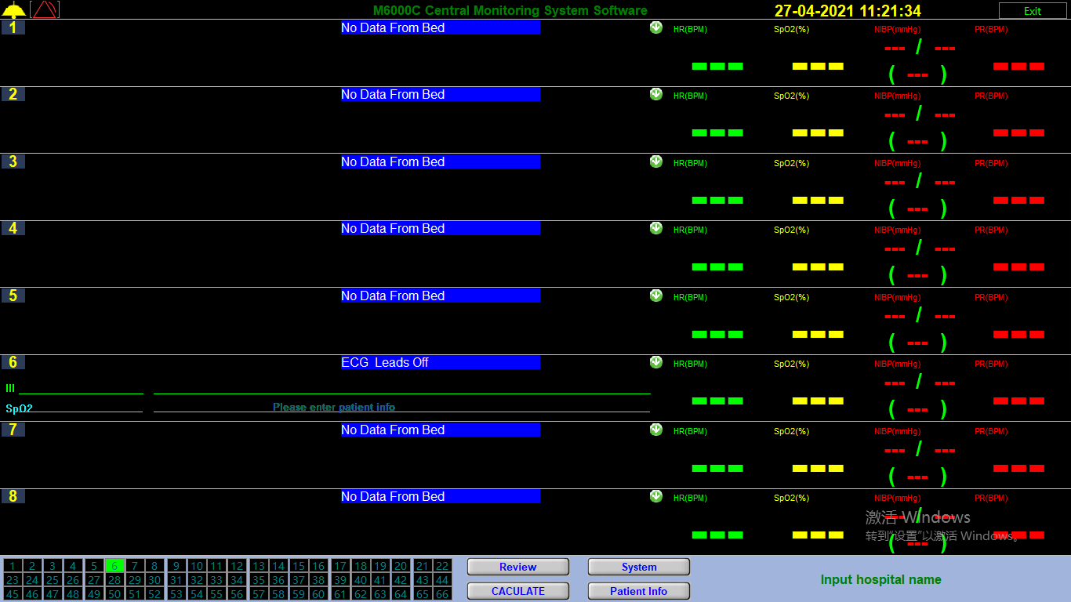
How to connect the central station
Successful connection

Slide 35
Catalogue
Appearence
Configuration
New Functions
Upgrate
Patient central station
Internal structure◀
Maintenance & Cleaning
Notes

Slide 36
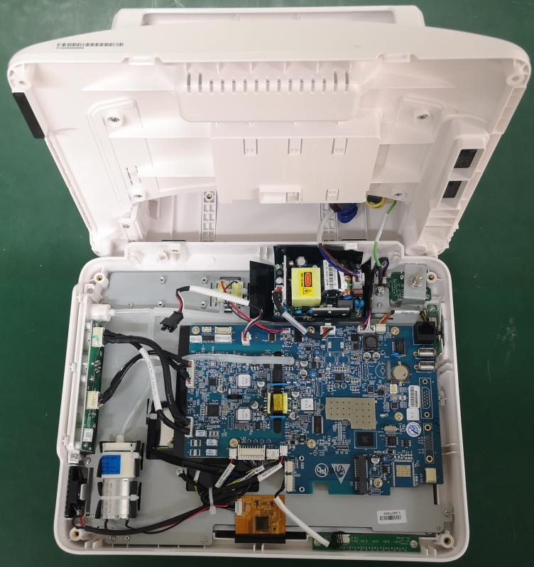
Internal structure
Power modules
Parameter
interface
board
Mainboard
Alarm light
NIBP pump

Slide 37
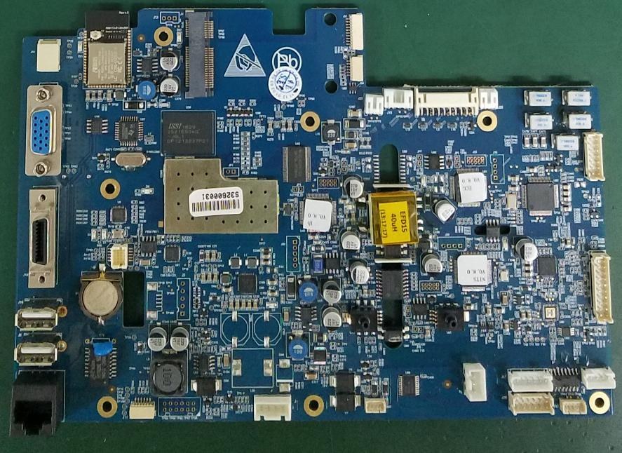
Mainboard-- All in one
12.1 inch LCD board connector
10.4 inch LCD board connector
Display area
Extension interfaces
Parameters area
Optional function area
Power supply area

Slide 38
Internal structural advantages of M12
1. Compact structure, high integration strength and strong anti-interference ability.
2. Good heat dissipation.
3. Convenient selection of various functions.
4. Easy maintenance

Slide 39
Catalogue
Appearence
Configuration
New Functions
Upgrate
Patient central station
Internal structure
Maintenance & Cleaning◀
Notes

Slide 40
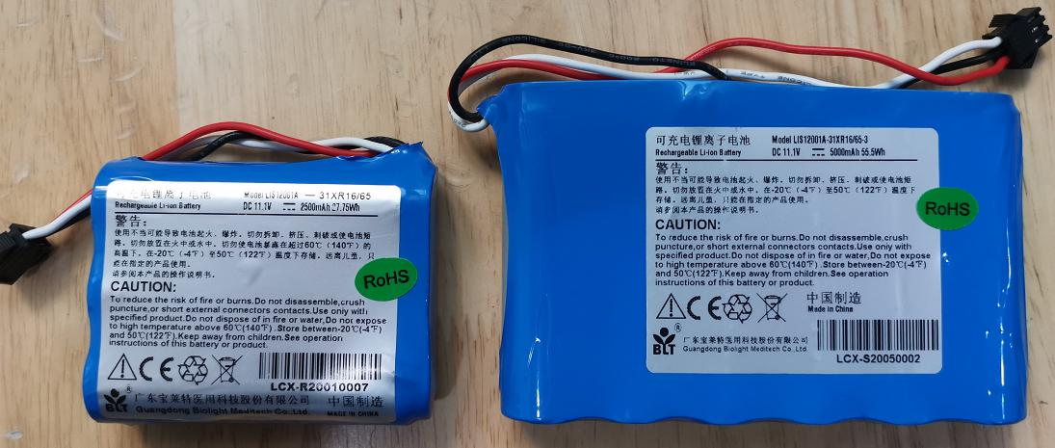
Battery maintenance
How
to check battery performance
1. Stop the monitoring work of the monitor.
2. Connect the AC power supply and continue to charge the battery until it is fully charged.
3. Disconnect the AC power supply, and let the monitor run on the battery until it is powered off.
4. The working time of the battery directly reflects its performance
Note：Please check the battery performance every 2 years.

Slide 41
Battery maintenance
How
to optimize a battery
1. Stop the monitoring work of the monitor.
2. Connect the AC power supply and continue to charge the battery until it is fully charged.
3. Unplug the AC power supply and let the monitor run on the battery until it is powered off.
4. Reconnect the monitor to the power code and charge the battery.
5. End of battery optimization

Slide 42
Battery maintenance
When
do you need
to optimize your battery
1.It is recommended to carry out two complete optimization cycles when using it for the first time.
2. The battery is used or stored for three months or the use time is obviously shortened, and the primary battery performance is optimized.
3. If you don't use it for a long time, optimize the battery once every three months.

Slide 43
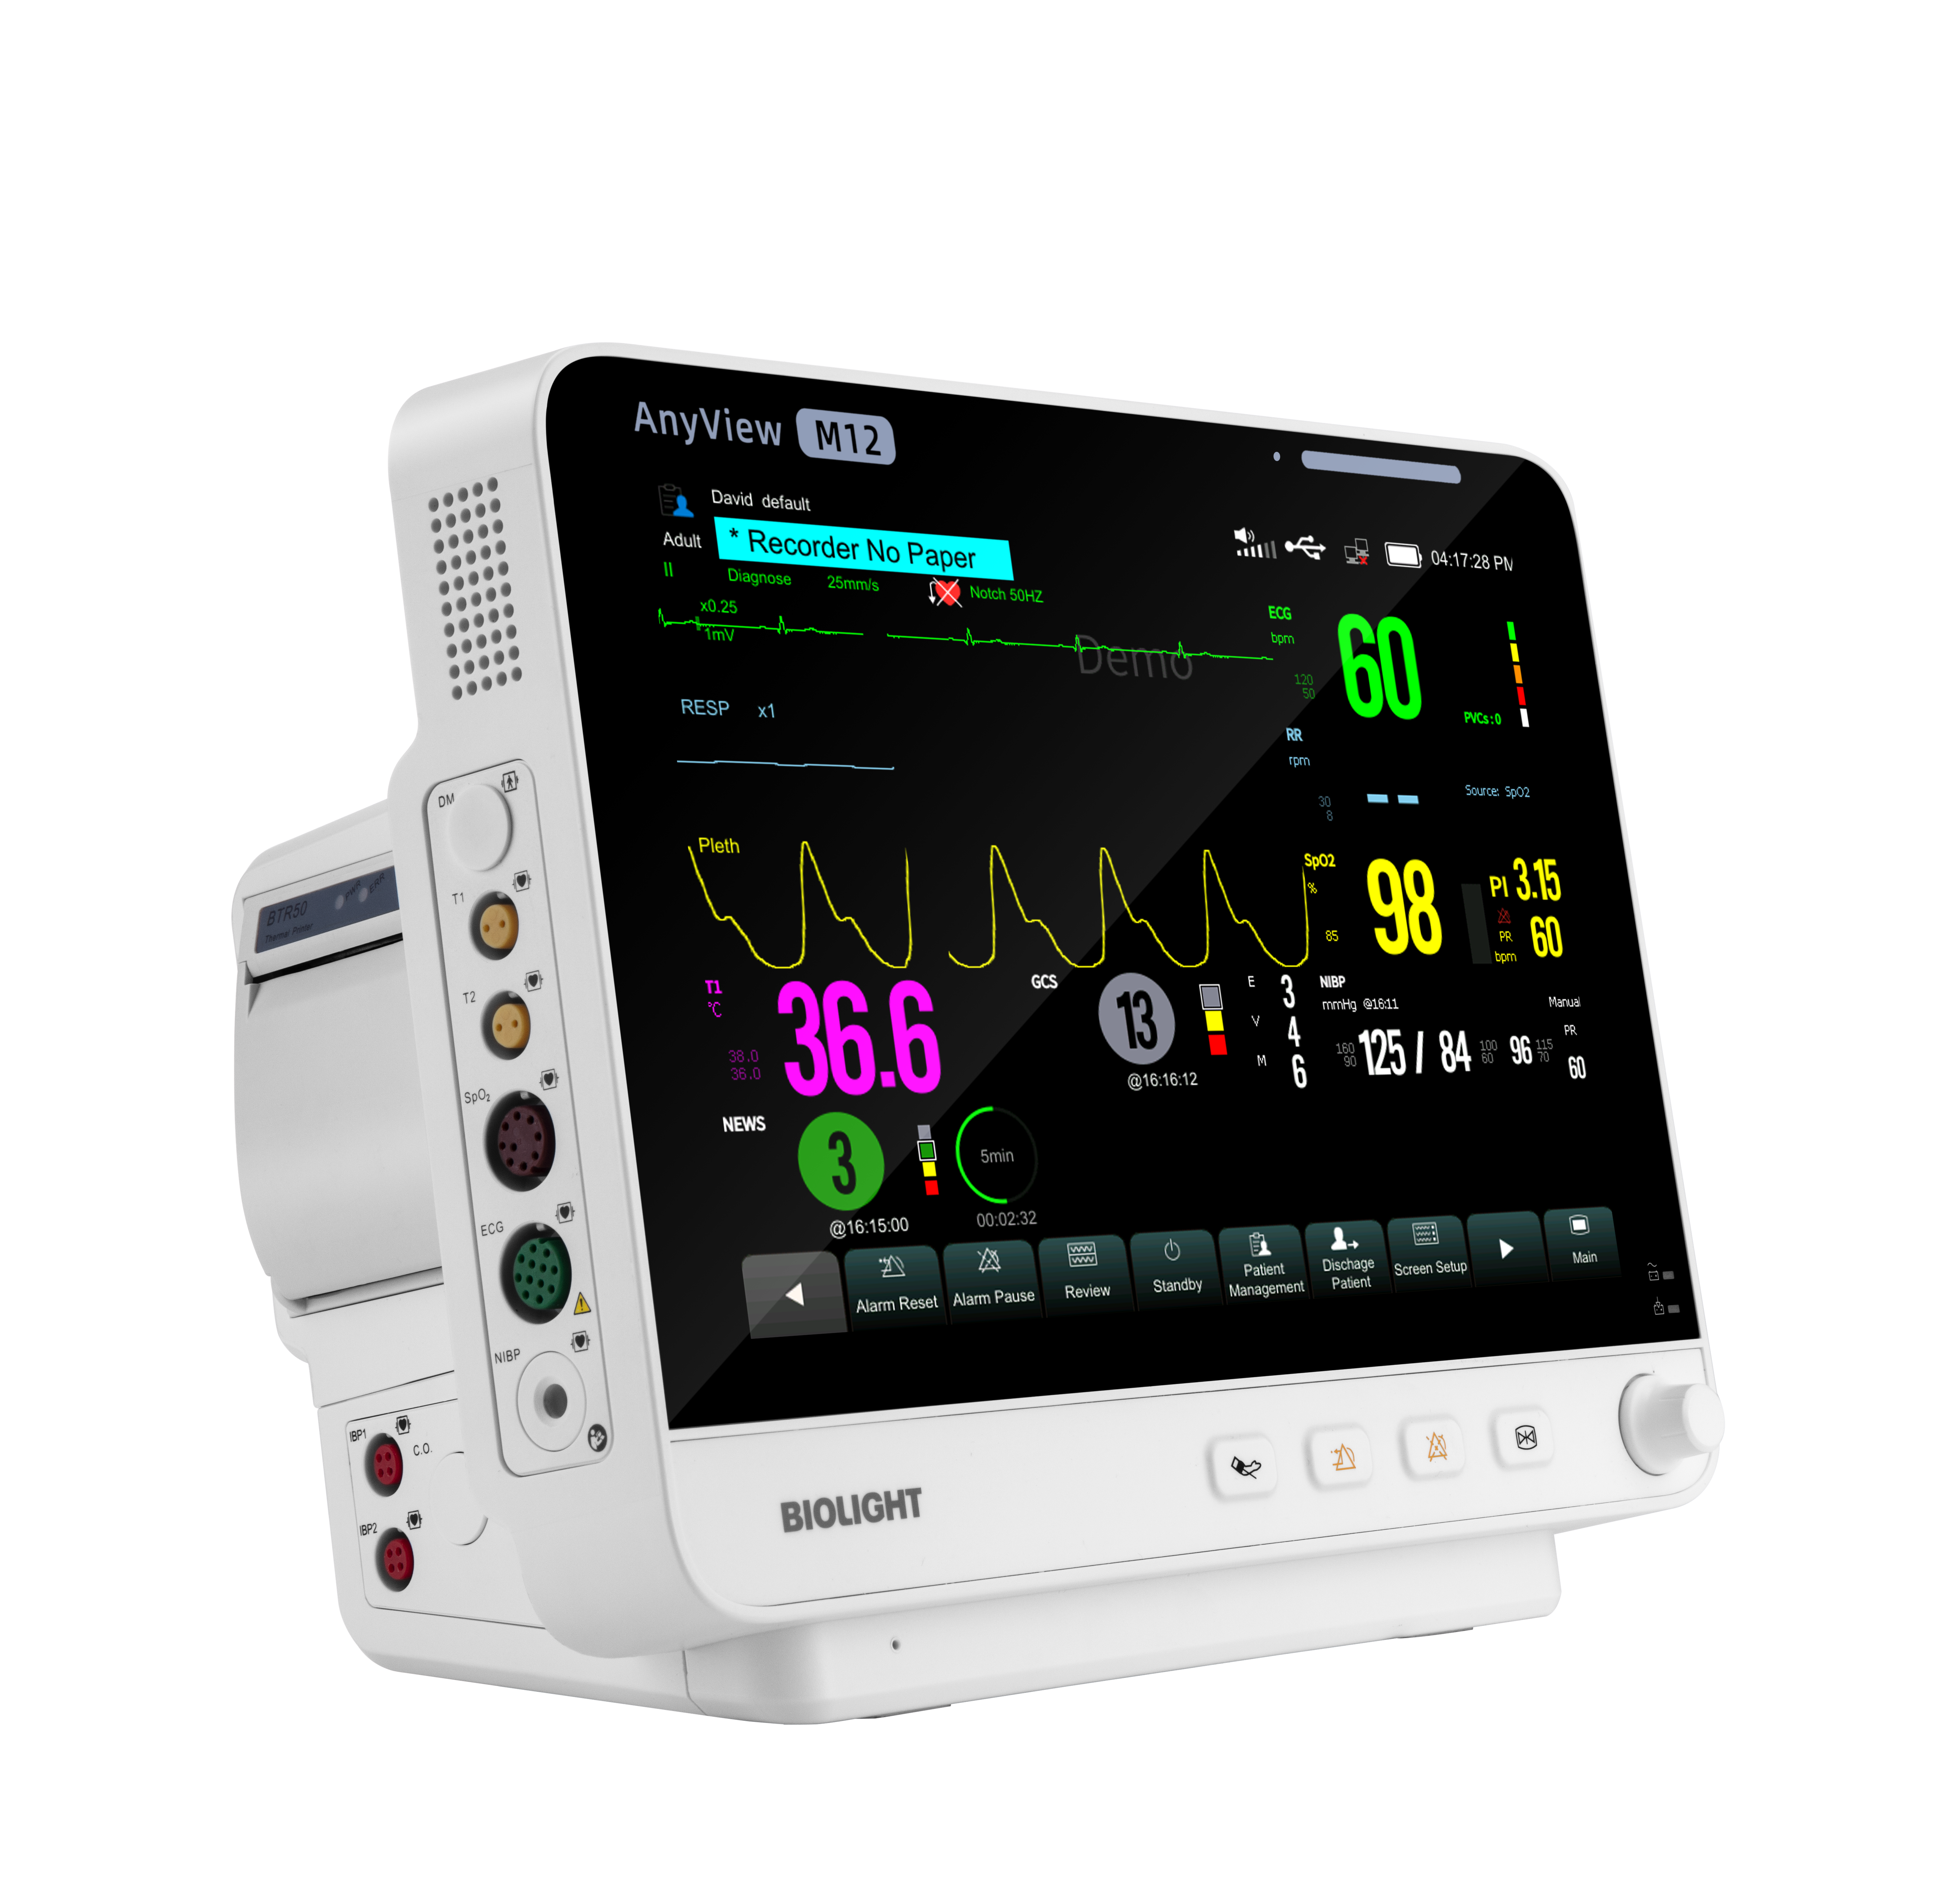
Cleaning of monitor
Non-corrosive detergents commonly used in hospitals can be used to clean the monitor, but it should be noted that many detergents must be diluted before use. Please follow the instructions of detergent manufacturers.
NOTE
Avoid using alcohol-based, amino-based or acetone-based cleaners.
Wipe the monitor housing and display screen with lint-free cloth or sponge soaked in detergent. Do not pour liquid on the instrument. Be careful when wiping to ensure that no water enters.
It is forbidden to use abrasive materials such as wire brushes or metal polishes, which will damage the display panel and screen.
Never soak the monitor in liquid.
When the plug of cable or accessory gets damp occasionally, please clean it with distilled water, and then dry it at 40℃-80℃ for at least 1 hour.

Slide 44
Cleaning of Accessories
Accessories | Cleanser | Cleaner Method
ECG cable | glutaraldehyde solution and 10% bleach solution | Clean the surface of the lead wire with a soft cloth stained with proper amount of clear water or neutral soapy water. Wipe the lead wire with a soft cloth stained with proper amount of disinfectant. Wipe the residual disinfectant with a soft cloth stained with clear water, and dry in a cool environment.
SpO ₂ probe | 70% isopropanol solution and 10% bleach solution
NIBP cuff | Clear water and neutral soapy water | Take the airbag out of the cuff Wash the cuff skin in clean neutral soapy water. Wipe the airbag and catheter with a soft cloth stained with proper amount of clear water or neutral soapy water. After the skin and airbag are fully dried, put them together and put into use.
Do not disinfect the lead wire with high pressure, radiation or steam, and do not directly soak the lead wire in liquid.
Air bags should not be dried at high temperature. Unless necessary, please do not clean the air bags inside too much.

Slide 45
Catalogue
Appearence
Configuration
New Functions
Upgrate
Patient central station
Internal structure
Maintenance & Cleaning
Notes◀

Slide 46
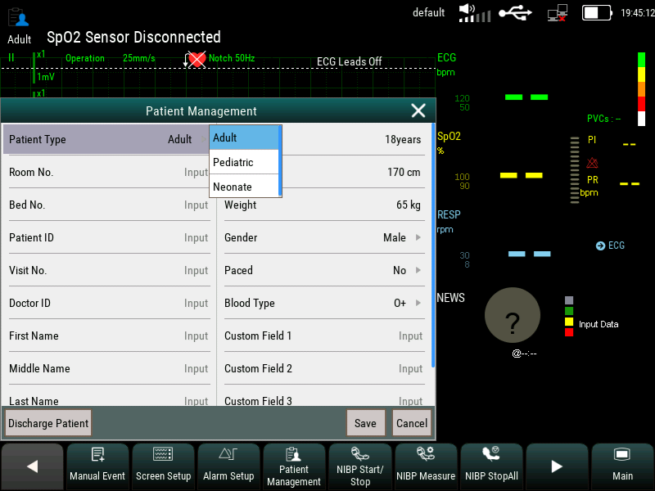
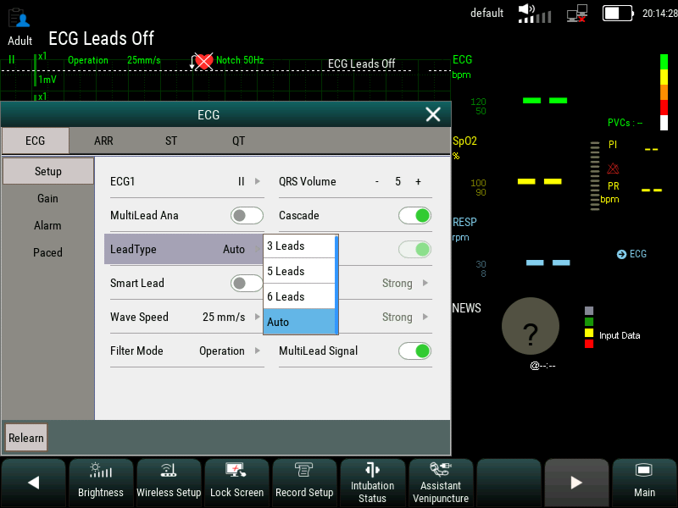
Select the patient type
select the lead type

Slide 47
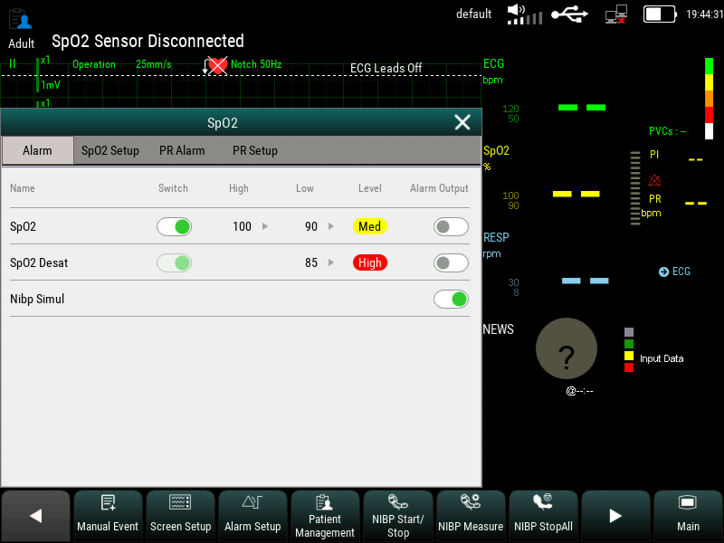
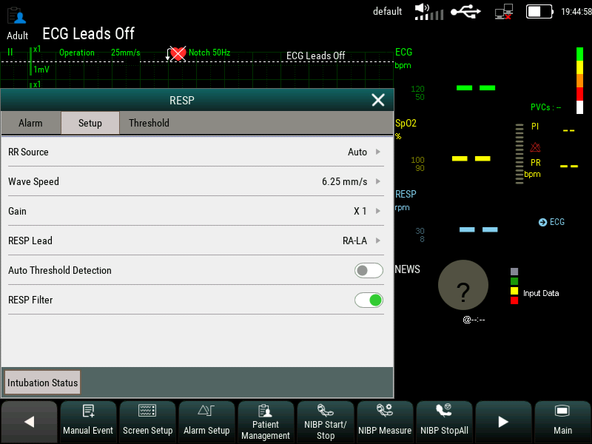
NIBP ipsilateral switch
Select RESP lead and RR source

Slide 48
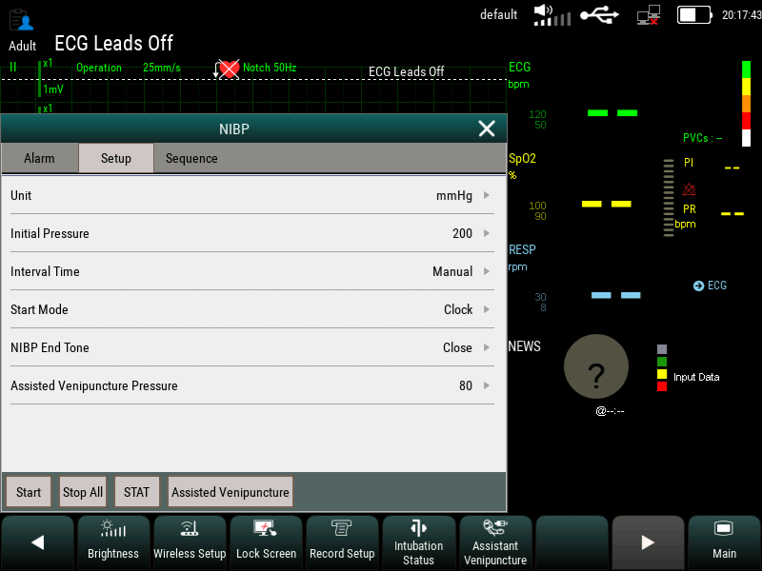

Slect the start mode and Interval time
set sequence

Slide 49
THANKS
For Your Watching
service@blt.com.cn

